Slide 1
Wave Optics, lecture 3, still lesson 1: Basics of Waves Optics, Light Sources and interferences
Teacher: Paul Briard
Lecture in classroom: 10:25-11:25
Then, we go in the Physics demonstration lab

Slide 2









Mathematical description of Young’s holes experiment
Complex electric field at P for both waves:
$$S_{1}$$
$${\vec{r}}_{1}$$
P
$${\tilde{E}}_{1}\left({\vec{r}}_{1},t\right)=E_{0,1}(r_{1})e^{i(ωt−{\vec{k}}_{1}{\vec{r}}_{1}+φ_{1})}$$
$${\tilde{E}}_{2}({\vec{r}}_{2},t)=E_{0,2}(r_{2})e^{i(ωt−{\vec{k}}_{2}{\vec{r}}_{2}+φ_{2})}$$
$${\vec{r}}_{2}$$
$$S_{2}$$
Light intensity at P:
$$I_{tot}=I_{1}+I_{2}+2\sqrt{I_{1}I_{2}}\cos{(Δφ)}$$
Screen
where $∆φ$ is the phase difference between both waves at P:
$$Δφ=\left(−kr_{1}+{kr}_{2}+φ_{1}−φ_{2}\right)$$
$I_{1}∝{\tilde{E}}_{1}$ ${{\tilde{E}}_{1}}^{∗}$
is the intensity at P if there was no point source $S_{2}$
$I_{2}∝{\tilde{E}}_{2}$ ${{\tilde{E}}_{2}}^{∗}$
is the intensity at P if there was no point source $S_{1}$

Slide 3



Mathematical description of Young’s holes experiment
If both waves at P have same amplitude, i.e. $E_{0,1}(r_{1})=E_{0,2}(r_{2})$, then
$$S_{1}$$
$$I_{tot}=2I_{0}\left[1+\cos\left(Δφ\right)\right]$$
$${\vec{r}}_{1}$$
P
(If the screen is quite far from the point sources compared to the distance between the point sources, we can consider $E_{0,1}(r_{1})≈E_{0,2}\left(r_{2}\right)$ )
$${\vec{r}}_{2}$$
$$S_{2}$$
And if we considere the incident wave at $S_{1}$ and $S_{2}$ have same phase, i.e. $φ_{1}=φ_{2}$:
Screen
$$Δφ=\frac{2π}{λ_{0}}\left(nr_{2}−nr_{1}\right)$$
$nr_{2}−nr_{1}$ is the optical path difference between the two waves which come from $S_{1}$ and $S_{2}$

Slide 4





The optical path
$$Light wave$$
$$A$$
$$B$$
$$d=AB$$
In a medium of uniform refractive index $n$, the light travels as straight line, and the optical path from A to B is described by:
$$δ=nd$$

Slide 5

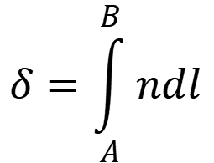
The optical path
$$Light wave$$
$$dl$$
$$B$$
$$A$$
In a medium of $non−$uniform refractive index $n$the light don’t travels as straight line, and the optical path from A to B is described by:
$$δ=\int_{A}^{B}{ndl}$$
$dl:$an infinitesimal displacement along the path
You will see later the how the variation of refractive index curve the light path.

Slide 6


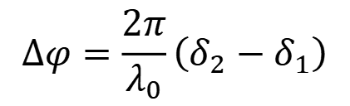
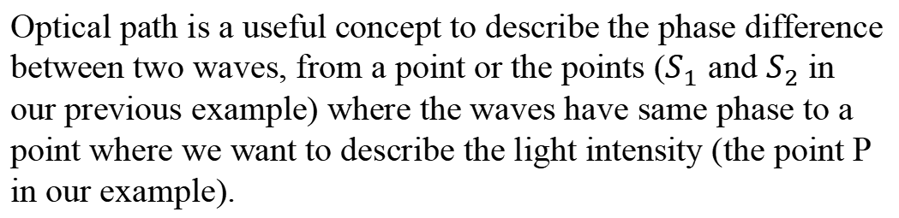
The optical path
Optical path is a useful concept to describe the phase difference between two waves, from a point or the points ($S_{1}$ and $S_{2}$ in our previous example) where the waves have same phase to a point where we want to describe the light intensity (the point P in our example).
The phase difference between both waves is:
$$Δφ=\frac{2π}{λ_{0}}\left(δ_{2}−δ_{1}\right)$$
Optical path from $S_{1}$ to P
Optical path from $S_{2}$ to P

Slide 7









Mathematical description of Young’s holes experiment
We are interested on a point P in the plane $y0x$ where are also $S_{1}$ and $S_{2}$(i.e. the z-coordinate of P , $S_{1}$ and $S_{2}$ is equal to 0).
$$Δφ=\frac{2π}{λ}\left(nr_{2}−nr_{1}\right)$$
Coordinates of P:${ x}_{P}$, $y_{P}$, $z_{P}$ ($z_{P}=0$)
$$x$$
$$\left(x_{p}±\frac{d}{2}\right)≪D$$
We consider that the distance Screen-holes D is such as:
After few mathematics ..
P
$$nr_{2}−{nr}_{1}≈\frac{nd}{D}x_{P}$$
$$S_{1}$$
$$r_{1}$$
$$d$$
$$z$$
$$r_{2}$$
$$O$$
$nr_{2}−{nr}_{1}$is proportional to $x_{P}$ and don’t depends to $y_{P}$
$$S_{2}$$
screen
If the waves propagates in air ($n≈1$),
$$nr_{2}−{nr}_{1}≈\frac{d}{D}x_{P}$$
$$y$$
$$D$$

Slide 8

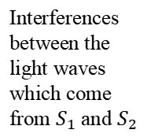

Young’s holes experiment with incident laser light
$$x$$
Interferences between the light waves which come from $S_{1}$ and $S_{2}$
$$S_{1}$$
$$S_{0}$$
Laser
$$S_{2}$$
Pinhole
Screen
Two Pinholes
http://www.maxicours.com/se/fiche/1/7/410471.html/ts
We consider a particular case where the phase at $S_{1}$ and $S_{2}$ is the same (they are at same distance from $S_{0}$)

Slide 9




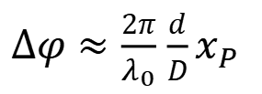
Mathematical description of Young’s holes experiment
$$Δφ=\frac{2π}{λ_{0}}\left(nr_{2}−nr_{1}\right)$$
$Δφ≈\frac{2π}{λ_{0}}$ $\frac{d}{D}x_{P}$
$$nr_{2}−{nr}_{1}≈\frac{nd}{D}x_{P}$$
$$n≈1$$
(propagation in air)
Phase difference between the waves at P
$$I_{tot}({ x}_{P}\text{, }y_{P})≈2I_{0}\left[1+\cos\left(\frac{2π}{λ_{0}} \frac{d}{D}x_{P}\right)\right]$$
$$I_{tot}=2I_{0}\left[1+\cos\left(Δφ\right)\right]$$
第13章 波动光学
I
4I₀
$$x_{P}$$
x₋₂
x₋₁
0
x₁
x₂
x₀
k
$$x_{P}$$

Slide 10





Mathematical description of Young’s holes experiment
$$I_{tot}({ x}_{P}\text{, }y_{P})≈2I_{0}\left[1+\cos\left(\frac{2π}{λ_{0}} \frac{nd}{D}x_{P}\right)\right]$$
Crest
I
4I₀
$$x_{P}$$
x₋₂
x₋₁
0
x₁
x₂
x₀
k
$$\frac{d}{D}x_{m}≈mλ_{0}$$
$$x_{m}≈m\frac{D}{d}λ_{0}$$
Constructive interferences:
$$n≈1$$
$m$ is an integer, positive, negative or equal to 0
(propagation in air)
$\frac{d}{D}x_{k}≈\left(m^{′}+\frac{1}{2}\right)$ $λ_{0}$
$$x_{m′}≈\left(m^{′}+\frac{1}{2}\right)\frac{D}{d}λ_{0}$$
Destructive interferences:
m$′$ is an integer, positive, negative or equal to 0

Slide 11



Mathematical description of Young’s holes experiment
$$I_{tot}({ x}_{P}\text{, }y_{P})≈2I_{0}\left[1+\cos\left(\frac{2π}{λ_{0}} \frac{d}{D}x_{P}\right)\right]$$
$$x_{m}=m\frac{D}{d}λ_{0}$$
Crests at
crest
I
4I₀
$$x_{P}$$
x₋₂
x₋₁
0
x₁
x₂
x₀
k
$$x_{m+1}−x_{m}$$
$$x_{m+1}−x_{m}=\frac{D}{d}λ_{0}$$
Distance between two consecutive crests:
The distance between the crests of intensity depends on $d$ and $λ_{0}$!
It is possible to measure $λ_{0}$ if $d$ is known or $d$ if $λ_{0}$ is known !
Interferometry is a science of measurement

Slide 12

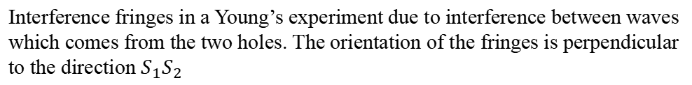
Young’s experiment
$$x_{P}$$
Destructive interferences
Constructive interferences
$$y_{P}$$
http://www.maxicours.com/se/fiche/1/7/410471.html/ts
Interference fringes in a Young’s experiment due to interference between waves which comes from the two holes. The orientation of the fringes is perpendicular to the direction $S_{1}S_{2}$

Slide 13









Important to remember:
You don’t need to remember all the demonstration and result we have seen.
What is important to remember is, the intensity on the screen is described by:
$$x$$
$$I_{tot}=I_{1}+I_{2}+2\sqrt{I_{1}I_{2}}\cos{(Δφ)}$$
$$S_{1}$$
$$r_{1}$$
P
$$d$$
If $I_{1}=I_{2}=I_{0}$, then:
$$r_{2}$$
$$I_{tot}=2I_{0}\left[1+\cos\left(Δφ\right)\right]$$
$$S_{2}$$
The phase difference between the waves is, if the phase is the same at $S_{1}$ and $S_{2}$:
$$Δφ=\frac{2π}{λ_{0}}\left(nr_{2}−nr_{1}\right)=\frac{2π}{λ_{0}}\left(δ_{2}−δ_{1}\right)$$
$$D$$
$nr_{2}−nr_{1}$ is the difference of optical path between the waves at P.
If $n≈1$ and $D≫d:$
$nr_{2}−nr_{1}≈$ $\frac{d}{D}x_{P}$

Slide 14
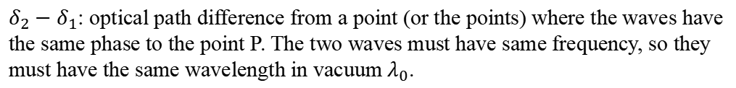

Light interferences between two waves in any situation
Light intensity at P, where two waves interfere:
$$I_{tot}=I_{1}+I_{2}+2\sqrt{I_{1}I_{2}}\cos{(Δφ)}$$
This equation describes the light interferences at a point P between two waves in any interferometric situation, not only the Young’s experiment.
$I_{1}$: The light intensity if there was only the first wave.
$I_{2}$: The light intensity if there was only the second wave.
$Δφ$: the phase difference between the wave described by:
$$Δφ=\frac{2π}{λ_{0}}\left(δ_{2}−δ_{1}\right)$$
$δ_{2}−δ_{1}$: optical path difference from a point (or the points) where the waves have the same phase to the point P. The two waves must have same frequency, so they must have the same wavelength in vacuum $λ_{0}$.

Slide 15


Difference between young holes and young slits experiments
Interference pattern with two holes:
Interference pattern with two slits:
This pattern is because of diffraction.
To focus on the interferences between waves from two point sources, we have ignored the effect of the diffraction phenomenon ... There is also diffraction pattern corresponding to the holes (the pattern depends on the shape of the aperture).

Slide 16
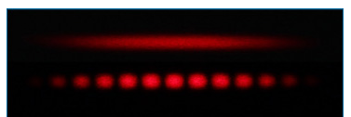
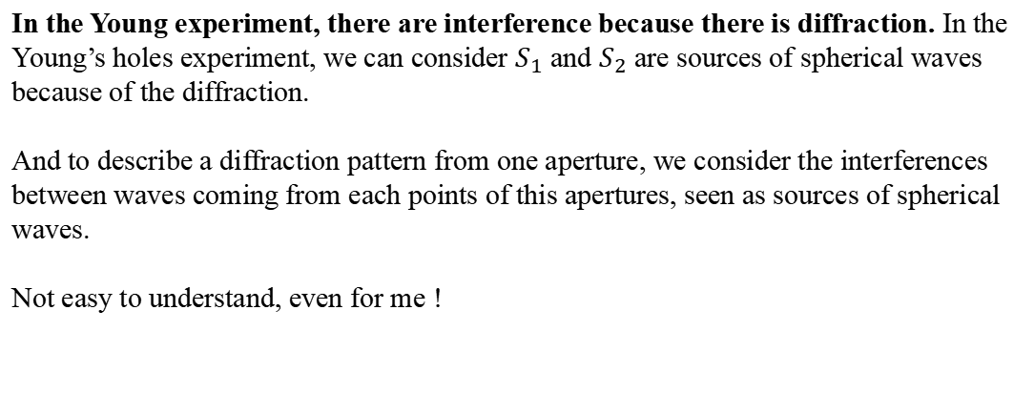
What about diffraction ?
If only one slit is illuminated (we observe the diffraction)
Interference pattern for two slits (diffraction +interferences between waves from both slits)
In the Young experiment, there are interference because there is diffraction. In the Young’s holes experiment, we can consider $S_{1}$ and $S_{2}$ are sources of spherical waves because of the diffraction.
And to describe a diffraction pattern from one aperture, we consider the interferences between waves coming from each points of this apertures, seen as sources of spherical waves.
Not easy to understand, even for me !

Slide 17
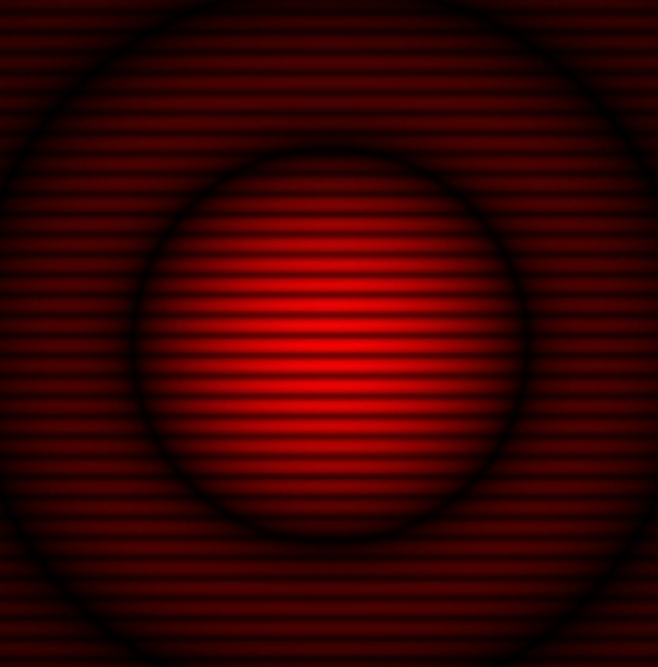
What about diffraction ?
Interference + diffraction pattern for two circular holes (take care a hole is never strictly a source point)
What have shown you previously, to show the interferences from two sources points.
http://www.maxicours.com/se/fiche/1/7/410471.html/ts
About a diffraction pattern by a circular hole and the diffraction by a slit, you will see details later)

Slide 18
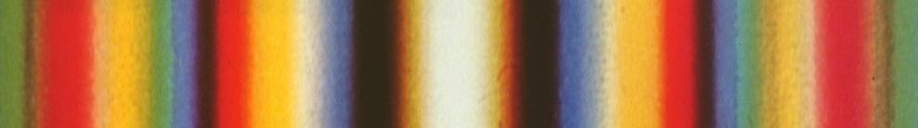
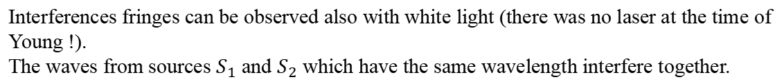
Interference fringes white light instead of laser light
Interference fringes for white light (many $λ$)
Interferences fringes can be observed also with white light (there was no laser at the time of Young !).
The waves from sources $S_{1}$ and $S_{2}$ which have the same wavelength interfere together.

Slide 19
To conclude about Young experiment
Young’s experiment is very important in the history. It is the evidence than the light can’t be only particles ! It is also waves !

Slide 20
End of the lesson 1.

Slide 21
Wave Optics lesson 2: Interferometric experiments
Teacher: Dr. Paul Briard

Slide 22
Contents
Optical path and half-wave loss
Thin film interferences
Michelson interferometer
Newton’s rings
Lloyd’s mirror experiment

Slide 23
1. Optical path and half-wave loss

Slide 24

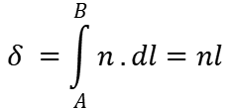
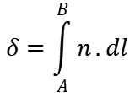


The optical path length in air
$$l$$
$$B$$
$$dl$$
$$A$$
$$δ=\int_{A}^{B}{n}.dl$$
The optical path length of light propagated from A to B in a medium of refractive index $n$ is:
In a medium of uniform refractive index, the light propagates in straight line and:
$$δ =\int_{A}^{B}{n}.dl=nl$$
$$l$$
$$B$$
$$A$$
$$dl$$
In air ($n≈1$)
Important to remember
$$δ≈l$$

Slide 25



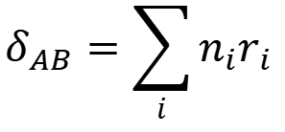
Optical path in various media
In one medium of uniform refractive index, optical path $δ_{AB}$ from A to B:
Refractive index
A
B
$$n$$
$δ_{AB}$ $=nr$
path travelled
$$r$$
$$φ_{B}−φ_{A}=\frac{2πr}{λ}=\frac{2πnr}{λ_{0}}$$
Wavelength in vacuum
A
B
Phase at B
Phase at A
λ
……
In various media, optical path from A to B:
$$δ_{AB}=\sum_{i}{n_{i}r_{i}}$$
光程
$$φ_{B}−φ_{A}=\frac{2π}{λ_{0}}\sum_{i}{n_{i}r_{i}}$$

Slide 26









Optic path difference between two waves
For instance, n’ is the refractive index of air, and n the refractive index of glass.
$$S_{1}$$
$$r_{1}$$
$$n′$$
$$r_{2}$$
$$S_{2}$$
$$P$$
$$d$$
$$δ_{S_{1}P} =n′r_{1}$$
Optical path difference between the waves:
$δ_{S_{2}P}−δ_{S_{1}P} =n′\left(r_{2}−d\right)$ $+nd−n′r_{1}$
$δ_{S_{2}P}=n′\left(r_{2}−d\right)$ $+nd$
Phase difference at P between the waves from $S_{1}$ and $S_{2}$:
$$Δφ=φ_{1}−φ_{2}+\frac{2π}{λ_{0}}\left(δ_{S_{2}P}−δ_{S_{1}P}\right)$$
$φ_{2}$:phase at $S_{1}$
$φ_{1}$:phase at $S_{2}$
The Young’s experiment can permit to measure the refractive index $n$

Slide 27


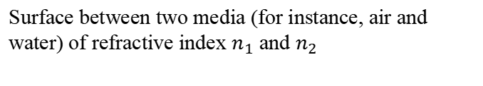
Half-wave loss due to the reflection
As a mechanical wave can be reflected, light waves can be reflected. They are reflected by the separation between two media (thus, not only by mirrors).
Incident light
$$n_{1}$$
$$n_{2}$$
Surface between two media (for instance, air and water) of refractive index $n_{1}$ and $n_{2}$
Is there a phase shift between the incident wave and the reflected wave due to the reflection ?

Slide 28


Half-wave loss due to the reflection
$$n_{1}$$
$$n_{2}$$
Incident wave
Transmitted wave
Reflected wave
Interface between a medium of $n_{1}$ and a medium refractive index of refractive index $n_{2}$
If $n_{1}>n_{2}$ there is no half-wave loss.
If $n_{1}<n_{2}$ there is half-wave loss, i.e. extra path of $\frac{λ}{2}$ for the reflected wave to consider.
There is no half-wave loss for the transmitted wave (for any refractive index)

Slide 29
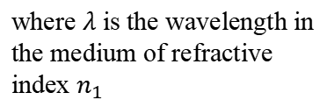


Half-wave loss due to the reflection
$$P$$
$$d$$
A plane wave is reflected.
$$n_{1}$$
$$n_{2}$$
If we don’t consider half-wave loss, the path difference between incident and reflected wave is, at P:
$$l=2d$$
If there is an half-wave loss due to the reflection and we consider it, the path difference between both waves is, at P :
$$l=2d+\frac{λ}{2}$$
where $λ$ is the wavelength in the medium of refractive index $n_{1}$

Slide 30

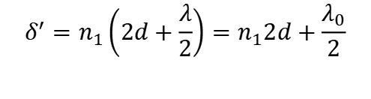

Half-wave loss due to the reflection
$$P$$
$$d$$
A wave is reflected.
$$n_{1}$$
$$n_{2}$$
If we don’t consider half-wave loss, the optical path difference between incident and reflected wave is:
$$δ=n_{1}l=n_{1}2d$$
If there is an half-wave loss due to the reflection and we consider it, the optical path difference between both waves is:
$$δ^{′}=n_{1}\left(2d+\frac{λ}{2}\right)=n_{1}2d+\frac{λ_{0}}{2}$$
where $λ_{0}$ is the wavelength in vacuum of the wave
It is strange that the extra-optical path due to the reflection is the half of a wavelength in vacuum for a reflection in a medium which is not vacuum, but there is no mistake, here.

Slide 31
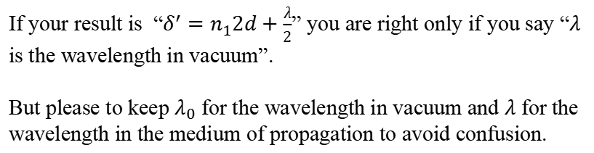

Half-wave loss due to the reflection
$$δ^{′}=n_{1}\left(2d+\frac{λ}{2}\right)=n_{1}2d+\frac{λ_{0}}{2}$$
where $λ_{0}$ is the wavelength in the vacuum of the wave
If your result is “$δ^{′}=n_{1}2d+\frac{λ}{2}$” you are right only if you say “$λ$ is the wavelength in vacuum”.
But please to keep $λ_{0}$ for the wavelength in vacuum and $λ$ for the wavelength in the medium of propagation to avoid confusion.
!
It is easy to confuse wavelength in vacuum and wavelength in medium so take care !

Slide 32
End of the lecture 3

